Slide 1
Date and Time

Slide 2
Introduction
Java 8 introduced the java.time package, which provides a comprehensive API for handling date and time more efficiently than the older java.util.Date and java.util.Calendar classes.

Slide 3
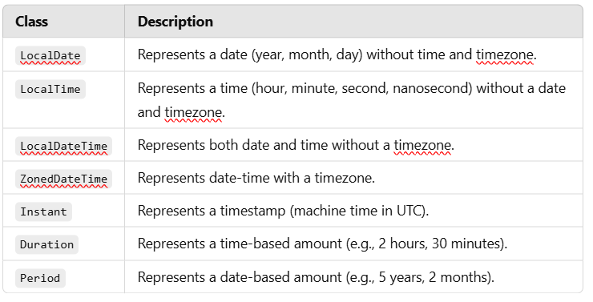
Key Classes in java.time

Slide 4
LocalDate –
import java.time.LocalDate;
public class DateExample {
public static void main(String[] args) {
LocalDate today = LocalDate.now();
System.out.println("Current Date: " + today);
LocalDate specificDate = LocalDate.of(2025, 3, 3);
System.out.println("Specific Date: " + specificDate);
}
}
Notes:
LocalDate.now() gets the current date from the system clock.
LocalDate.of(2025, 3, 3) creates a specific date (3rd March 2025).

Slide 5
LocalTime
import java.time.LocalTime;
public class TimeExample {
public static void main(String[] args) {
LocalTime now = LocalTime.now();
System.out.println("Current Time: " + now);
LocalTime specificTime = LocalTime.of(10, 30, 45);
System.out.println("Specific Time: " + specificTime);
}
}
Notes:
LocalTime.now() retrieves the current system time.
LocalTime.of(10, 30, 45) creates a specific time (10:30:45 AM).

Slide 6
LocalDateTime–
import java.time.LocalDateTime;
public class DateTimeExample {
public static void main(String[] args) {
LocalDateTime now = LocalDateTime.now();
System.out.println("Current DateTime: " + now);
LocalDateTime specificDateTime = LocalDateTime.of(2025, 3, 3, 10, 30);
System.out.println("Specific DateTime: " + specificDateTime);
}
}
Notes:
LocalDateTime.now() fetches the current date and time.
LocalDateTime.of(2025, 3, 3, 10, 30) sets a specific date-time.

Slide 7
Formatting Date and Time –
import java.time.LocalDateTime;
import java.time.format.DateTimeFormatter;
public class FormattingExample {
public static void main(String[] args) {
LocalDateTime now = LocalDateTime.now();
DateTimeFormatter formatter = DateTimeFormatter.ofPattern("dd-MM-yyyy HH:mm:ss");
String formattedDateTime = now.format(formatter);
System.out.println("Formatted DateTime: " + formattedDateTime);
}
}
Notes:
DateTimeFormatter.ofPattern("dd-MM-yyyy HH:mm:ss") defines a custom format.
now.format(formatter) formats the LocalDateTime into a readable string.
HH (uppercase) → 24-hour format (00 to 23).
hh (lowercase) → 12-hour format (01 to 12, requires a for AM/PM).

Slide 8
Duration and Period –
import java.time.*;
public class DurationPeriodExample {
public static void main(String[] args) {
Duration duration = Duration.ofHours(5);
System.out.println("Duration of 5 hours: " + duration);
Period period = Period.ofMonths(3);
System.out.println("Period of 3 months: " + period);
}
}
Notes:
Duration.ofHours(5) creates a time duration of 5 hours.
Period.ofMonths(3) creates a period of 3 months.
Output - PT5H (PT → Represents a period of time.
5H → Means 5 hours.)
P3M – (P → Represents a period.
3M → Means 3 months.)

Slide 9
Practice Examples –
Finding the Difference Between Two Dates –
import java.time.LocalDate;
import java.time.Period;
public class DateDifference {
public static void main(String[] args) {
LocalDate startDate = LocalDate.of(2022, 1, 1);
LocalDate endDate = LocalDate.of(2025, 3, 3);
Period difference = Period.between(startDate, endDate);
System.out.println("Difference: " + difference.getYears() + " years, " +
difference.getMonths() + " months, " + difference.getDays() + " days");
}
}
Notes:
Period.between(startDate, endDate) calculates the difference in years, months, and days.

Slide 10
Adding and Subtracting Days, Months, and Years –
import java.time.LocalDate;
public class DateManipulation {
public static void main(String[] args) {
LocalDate today = LocalDate.now();
LocalDate futureDate = today.plusMonths(6);
LocalDate pastDate = today.minusYears(2);
System.out.println("Today's Date: " + today);
System.out.println("Date After 6 Months: " + futureDate);
System.out.println("Date 2 Years Ago: " + pastDate);
}
}
Notes:
plusMonths(6) adds 6 months to the current date.
minusYears(2) subtracts 2 years from the current date.

Slide 11
Getting the Day of the Week –
import java.time.LocalDate;
import java.time.DayOfWeek;
public class DayOfWeekExample {
public static void main(String[] args) {
LocalDate date = LocalDate.of(2025, 3, 3);
DayOfWeek dayOfWeek = date.getDayOfWeek();
System.out.println("The day of the week for " + date + " is: " + dayOfWeek);
}
}
Notes:
getDayOfWeek() returns the name of the weekday for a given date.

Slide 12
Converting String to LocalDate
import java.time.LocalDate;
import java.time.format.DateTimeFormatter;
public class StringToDate {
public static void main(String[] args) {
String dateStr = "03-03-2025";
DateTimeFormatter formatter = DateTimeFormatter.ofPattern("dd-MM-yyyy");
LocalDate date = LocalDate.parse(dateStr, formatter);
System.out.println("Converted Date: " + date);
}
}
Notes:
DateTimeFormatter.ofPattern("dd-MM-yyyy") specifies the expected date format.
LocalDate.parse(dateStr, formatter) converts a string into a LocalDate.

Slide 13
Convert LocalDateTime to ZonedDateTime
You can convert a LocalDateTime to a specific time zone using ZoneId:
import java.time.LocalDateTime;
import java.time.ZoneId;
import java.time.ZonedDateTime;
public class Main {
public static void main(String[] args) {
// Get current LocalDateTime
LocalDateTime localDateTime = LocalDateTime.now();
// Specify the desired time zone (e.g., Asia/Kolkata)
ZoneId zoneId = ZoneId.systemDefault(); // or ZoneId.of("Asia/Kolkata")
// Convert LocalDateTime to ZonedDateTime
ZonedDateTime zonedDateTime = localDateTime.atZone(zoneId);
// Print the result
System.out.println("LocalDateTime: " + localDateTime);
System.out.println("ZonedDateTime: " + zonedDateTime);
}
}
Notes:
atZone(ZoneId.systemDefault()) converts the local time to a specific timezone.
toInstant() converts it to UTC.

Slide 14
Convert LocalDateTime to Different Time Zones Write a Java program that:
Gets the current LocalDateTime.
Converts it to New York (America/New_York) time zone.
Converts it to London (Europe/London) time zone.
Prints both converted date-time values.
Hint: Use ZonedDateTime and ZoneId.
Calculate Age from Date of Birth
Write a Java program that:
Takes a user's date of birth (YYYY-MM-DD format) as input.
Calculates and prints their current age in years.
Hint: Use Period.between().
Find the Duration Between Two Instants
Write a Java program that:
Records the current Instant before starting a loop that runs for 5 million iterations.
Records the Instant after the loop completes.
Calculates and prints the time taken in seconds and milliseconds.
Use Instant.now() and Duration.between().

Slide 15
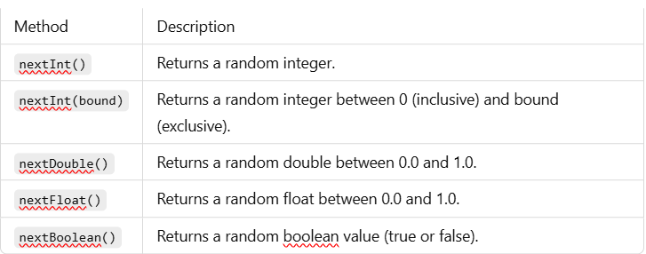
Random Class (java.util.Random)
The Random class is used to generate pseudo-random numbers of different data types.
Key methods of Random class-

Slide 16
Generating Random Numbers –
import java.util.Random;
public class RandomExample {
public static void main(String[] args) {
Random random = new Random();
int randomInt = random.nextInt(100); // Random integer between 0 and 99
System.out.println("Random Integer: " + randomInt);
double randomDouble = random.nextDouble(); // Random double between 0.0 and 1.0
System.out.println("Random Double: " + randomDouble);
boolean randomBoolean = random.nextBoolean(); // Random boolean value
System.out.println("Random Boolean: " + randomBoolean);
}
}
Notes:
random.nextInt(100) generates a random integer from 0 to 99.random.
nextDouble() generates a random floating-point number between 0.0 and 1.0.
random.nextBoolean() generates a true/false value randomly.

Slide 17
Generating Random Numbers in a Range
import java.util.Random;
public class RandomRangeExample {
public static void main(String[] args) {
Random random = new Random();
int min = 50, max = 100;
int randomInRange = random.nextInt(max - min + 1) + min;
System.out.println("Random Integer in Range (50-100): " + randomInRange);
}
}
Notes:
random.nextInt(max - min + 1) + min ensures the random number is within the range [min, max].

Slide 18
Generating Random Characters (Alphabets)
import java.util.Random;
public class RandomCharacterExample {
public static void main(String[] args) {
Random random = new Random();
char randomChar = (char) (random.nextInt(26) + 'A'); // Random uppercase letter
System.out.println("Random Uppercase Letter: " + randomChar);
char randomLowerChar = (char) (random.nextInt(26) + 'a'); // Random lowercase letter
System.out.println("Random Lowercase Letter: " + randomLowerChar);
}
}
Notes:
random.nextInt(26) + 'A' generates a random uppercase letter from 'A' to 'Z'.
random.nextInt(26) + 'a' generates a random lowercase letter from 'a' to 'z'.

Slide 19
Generating Random OTP (6-digit)
import java.util.Random;
public class RandomOTPExample {
public static void main(String[] args) {
Random random = new Random();
int otp = 100000 + random.nextInt(900000); // Generates 6-digit OTP
System.out.println("Random OTP: " + otp);
}
}
Notes:
random.nextInt(900000) generates a number between 0 and 899999.
Adding 100000 ensures the number is at least 100000, making it a 6-digit number.

Slide 20
Generating Random Floating-Point Numbers in a Range
import java.util.Random;
public class RandomFloatExample {
public static void main(String[] args) {
Random random = new Random();
float min = 5.5f, max = 15.5f;
float randomFloat = min + random.nextFloat() * (max - min);
System.out.println("Random Float between 5.5 and 15.5: " + randomFloat);
}
}
Notes:
random.nextFloat() generates a number between 0.0 and 1.0.Multiplying by (max - min) scales it to the desired range.
Adding min shifts the range accordingly

Slide 21
Generating a Random Password
import java.util.Random;
public class RandomPasswordExample {
public static void main(String[] args) {
Random random = new Random();
String characters = "ABCDEFGHIJKLMNOPQRSTUVWXYZabcdefghijklmnopqrstuvwxyz0123456789!@#$%^&*";
StringBuilder password = new StringBuilder();
for (int i = 0; i < 8; i++) { // 8-character password
int index = random.nextInt(characters.length());
password.append(characters.charAt(index));
}
System.out.println("Random Password: " + password);
}
}
Notes:
The password consists of uppercase, lowercase, digits, and special characters.
random.nextInt(characters.length()) picks a random character from the string.

Slide 22
Question 1: Generating Random Integers
Write a Java program that generates 5 random integers between 1 and 100 (inclusive) using java.util.Random and prints them.
Use nextInt(bound) and adjust for the desired range.
Question 2: Simulating a Dice Roll
Simulate rolling a six-sided die using java.util.Random. The program should:
Generate a random number between 1 and 6.
Print the result of the dice roll.
Hint: Use nextInt(6) + 1.
Question 3: Generating Random Floating-Point Numbers
Write a Java program that generates a random floating-point number between 0.0 and 1.0 using java.util.Random. Then, modify the program to generate a random floating-point number between 5.5 and 10.5.
Hint: Use nextDouble() and adjust for the desired range.

